Slide 1

CUSTOMER PERSONALITY ANALYSIS
Group 3
Ms. Prerana Balasaheb Lagad
Mr. Sooraj Sheregar
Mr. Saikiran Mummareddy
Mr. Yash Hanamant Molawade
Ms. Rutuja Sudhakar Meshram

Slide 2
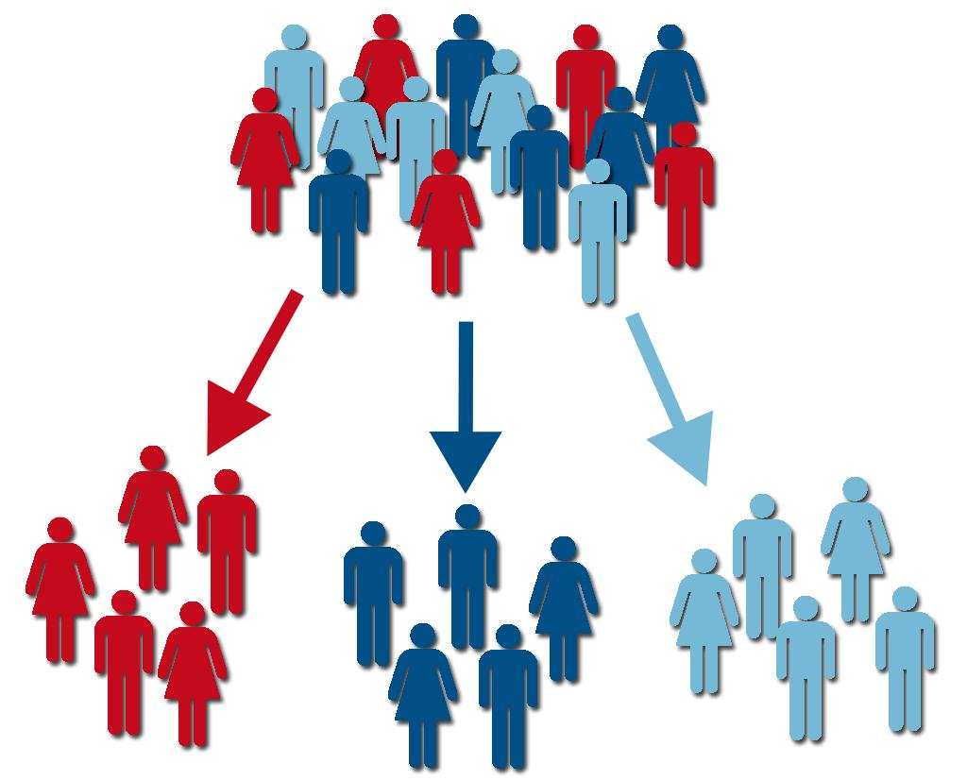
Buisness Objective
The business objective of this project is to analyse the customer behaviour to know which product to market and modify for different segments of customers.
Customer personality analysis helps a business to modify its product based on its target customers from different types of customer segments.
Finding the potential customers by analyzing the behavior of them is useful to understand the targeted customers.

Slide 3

STEPS INVOLVED
EXPLORATORY DATA ANALYSIS
MODEL BUILDING

Slide 4
STEPS INVOLVED IN EXPLORATORY DATA ANALYSIS
Data Collection
Importing necessary libraries
Data Exploration
Statistical Analysis
Data Cleaning
Feature Engineering
Univariate Analysis
Bivariate Analysis
Standardizing and Encoding the variables

Slide 5

Data Collection​
Importing necessary libraries​
Data Exploration​ & Statistical Analysis
Data is being collected from the marketing_campaign1.xlsx
Necessary libraries for data manipulation, analysis, visualization, computation etc.
Data Exploration and statistical analysis process involves process like checking for outliers , missing values, duplicate values etc

Slide 6
Data Cleaning & Feature Engineering
Since Z_CostContact & Z_Revenue are constant values we have droped these for further analysis.
The missing values in income are being grouped based on their level of education and is being replaced by its median.
Reducing features based on expense by grouping MntWines, MntFruits, MntMeatProducts, MntFishProducts, MntSweetProducts, MntGoldProds together
Reducing features based on No. Of Accepted campaigns.
Reducing features based on No. of purchases
Reducing features based on Education to Under-graduate, Post-graduate and PhD.
Age is found out from year of birth.
Reducing features based on Marital_Status to either alone or with a partner.
Reducing features based on No. of kids by adding up No. Of children and teens.
Reducing features based on family size based on marital status and No. of kids
Reducing features based on parenthood to either a parent or not a parent.
Dropping redundant columns

Slide 7
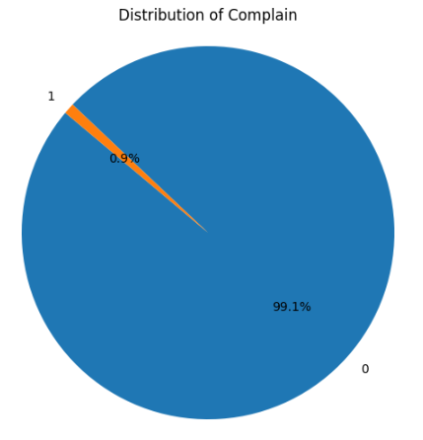
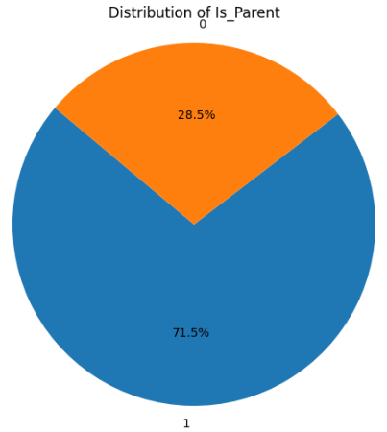
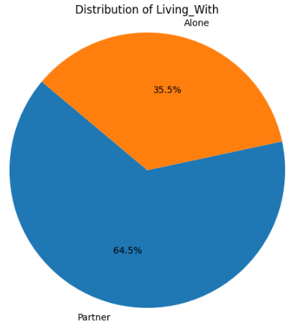
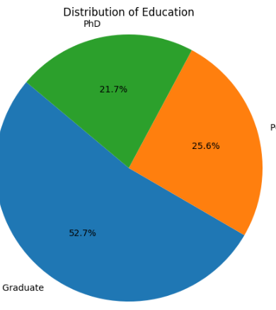
UNIVARIATE ANALYSIS
Through visualization it is found that
Majority of customers are parents
No. Of customers who are alone is 1/3rd of the total customer count
Close to 50% of the customers are Graduate and remaining two quarters are of post graduate and PhD holders
It is also found that less than 1% of the customers have complains

Slide 8
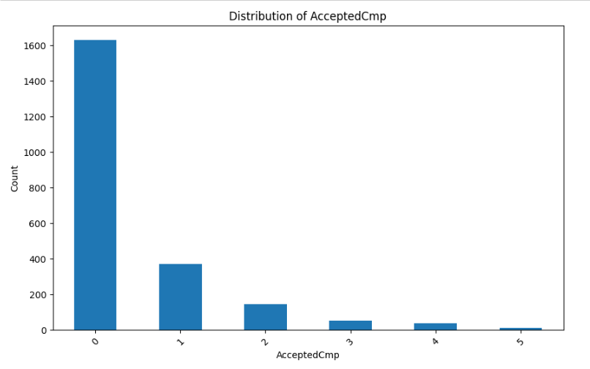
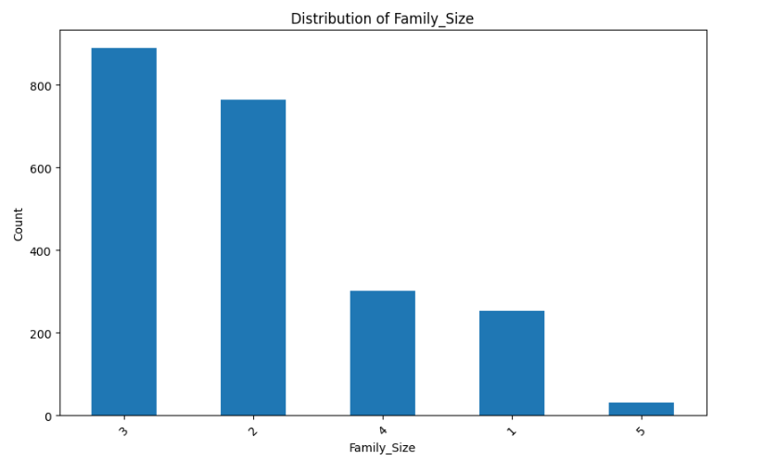
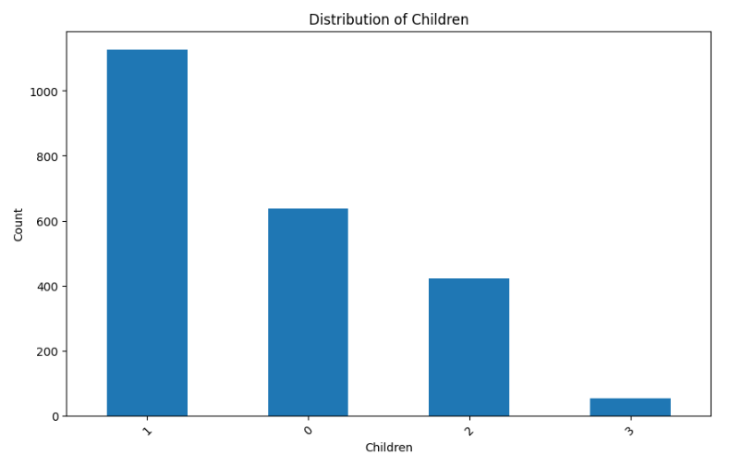
UNIVARIATE ANALYSIS
Overall Accepted campaign indicates that , most of the customers have not accepted any campaign
Most of the customers family size is either 2 or 3
Customer with no kids or with only 1 kid are more

Slide 9
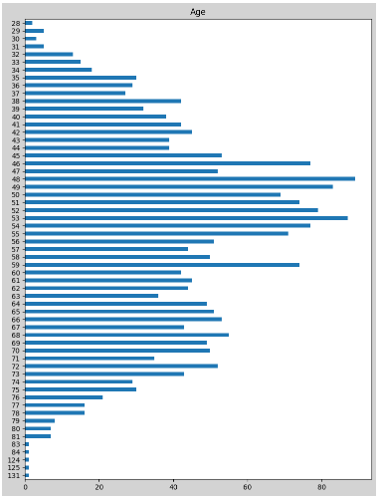
UNIVARIATE ANALYSIS
When age of the customer is considered it can be found that 40 to 75 age group are the highest & there are few outliers above age 90
We can also notice that age is slightly normally distributed

Slide 10
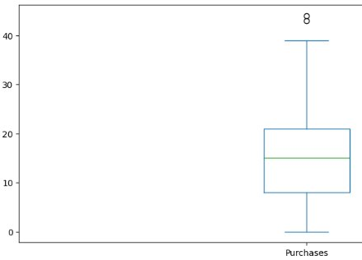
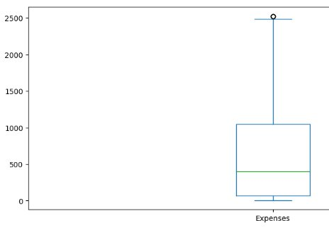
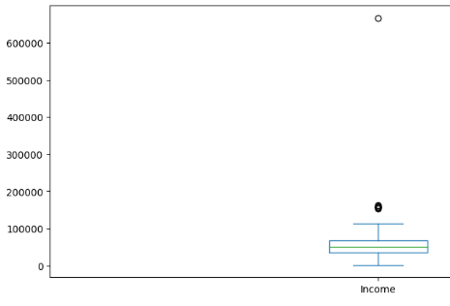
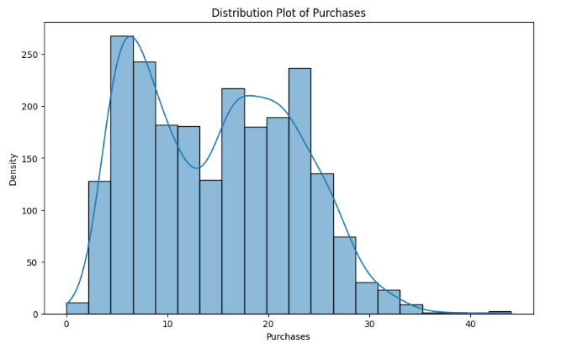
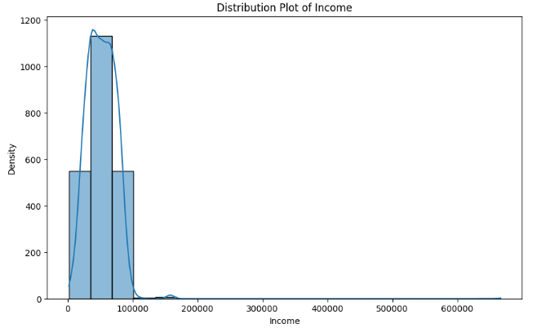
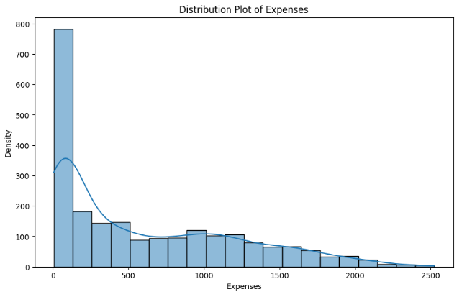
UNIVARIATE ANALYSIS
Income is slightly positively skewed
And through box plot the outliers can be identified
Income is positively skewed
And through box plot the outliers can be identified
Income is positively skewed with negative kurtosis
And through box plot the outliers can be identified

Slide 11
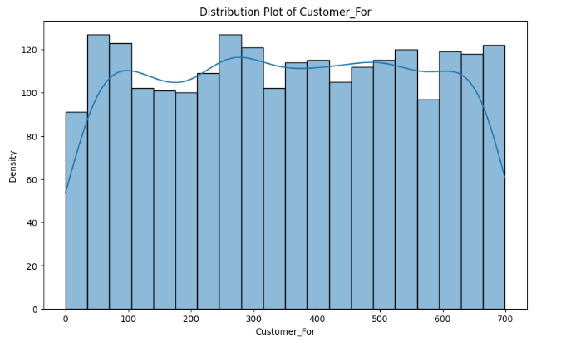
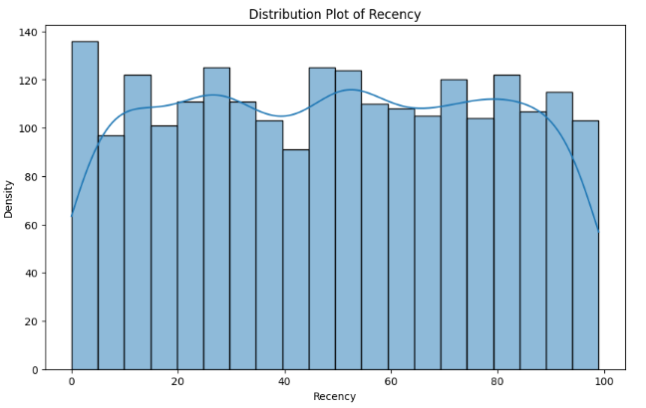
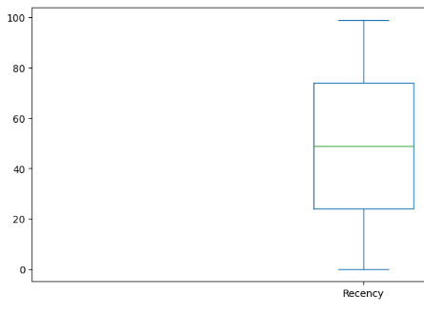
UNIVARIATE ANALYSIS
It is found that there isn't significant relation in Customer recency

Slide 12
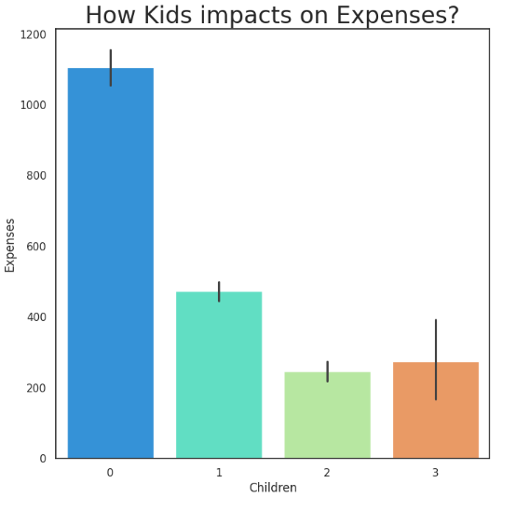
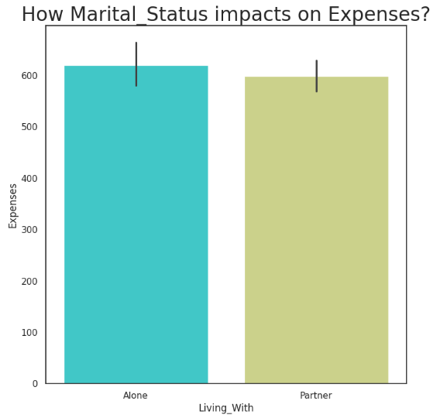
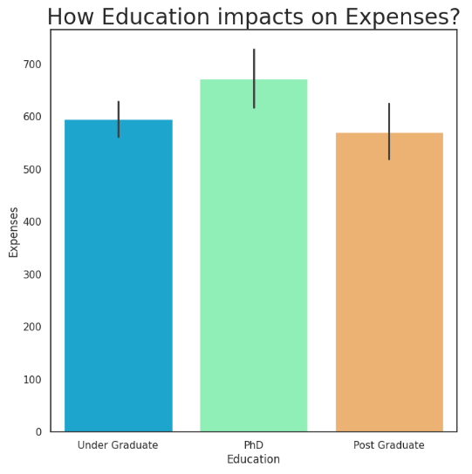
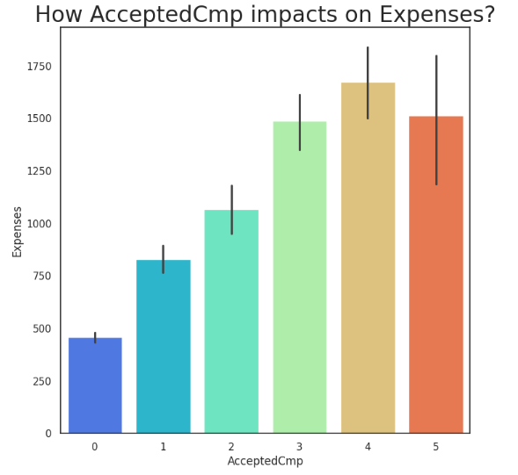
BIVARIATE ANALYSIS
By comparing features such as No. of kids, Marial Status, Education & Accepted campaigns v/s Expenses the relation between them is found out
From No.of kids it can be found that people with no kids have higher expense
We can notice that both maritial status and education level doesn’t affect Expense much
There is significant increase in expenses based on No.of Accepted campaighns

Slide 13
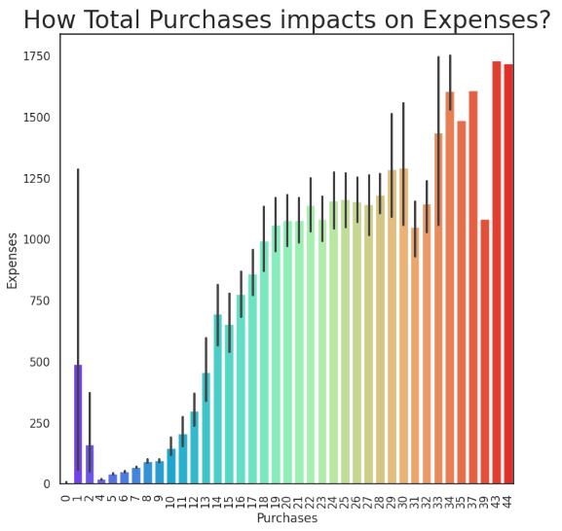
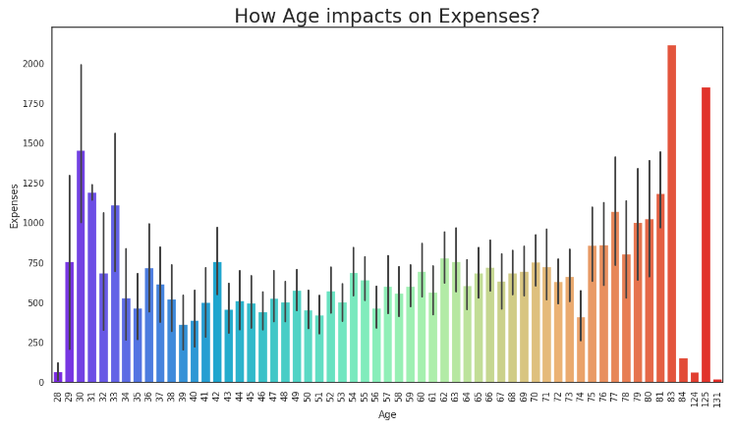
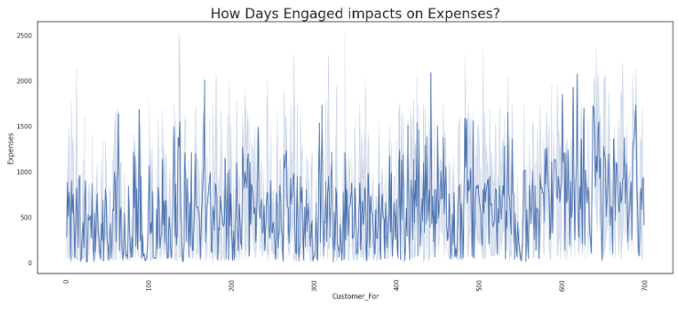
BIVARIATE ANALYSIS
Expense increases with the increase in total purchases
Expense of moderate age group i.e. age 35 to 75 is considerably lower than the expense by younger and older customers

Slide 14
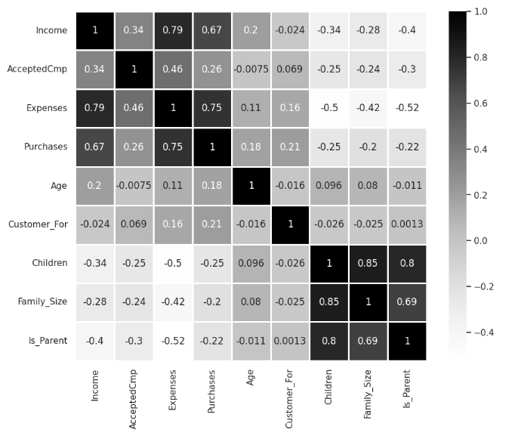
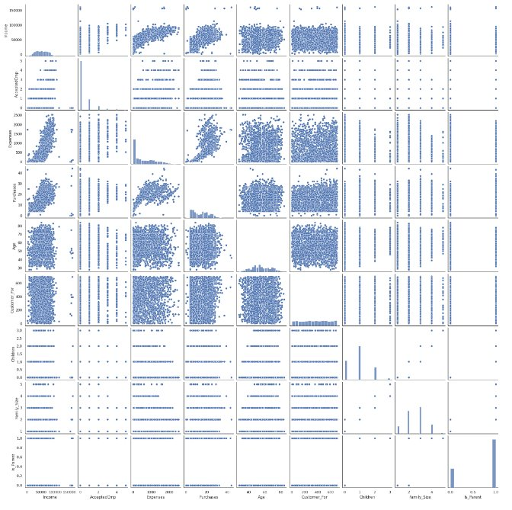
Correlation between various features is found out, more the correlation more the feature affect each other. The Pair-plot is also a visual representation for the effect of one feature with the other.

Slide 15
Standardizing and Encoding the variables
All the Numerical variable is standardized.
All the Categorical variable are Encoded using Label Encoder to 0 & 1

Slide 16

STEPS INVOLVED IN MODEL BUILDING
Dimensionality reduction
Clustering

Slide 17
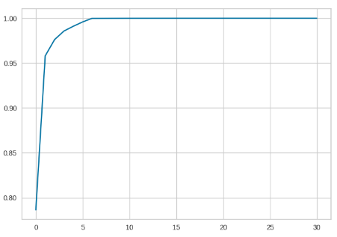
Dimensionality reduction
Performing Principal Component Analysis (PCA) to reduce the dimensionality of the dataset and visualize it in lower dimensions.
Cumulative Explained Variance is plot to determine the number of principal components to be retained, here we have considered 6.

Slide 18
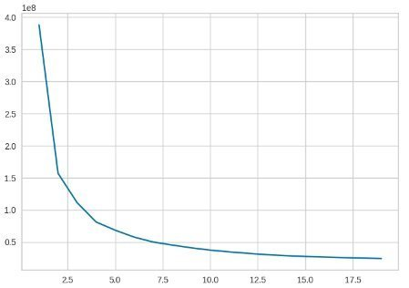
Clustering
Within-Cluster Sum of Squares (WCSS) is used to find out best number of clusters for our data
Plotting Elbow Curve: to determine the best no of cluster.
From the elbow curve obtained it is found out that 4 would be the best no of clusters for our analysis

Slide 19
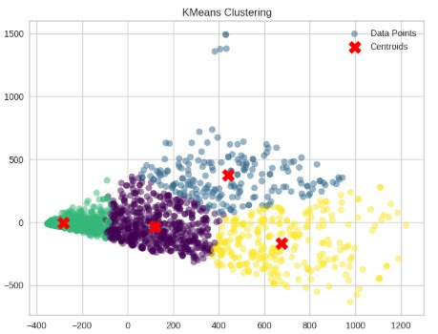
Clustering
The Kmeans model is fit with No of clusters as 4, Coordinates of the cluster centers are found out.
A scatter plot is created with the data points colored according to their cluster labels.
The centroids of the clusters are plotted as red 'X' markers.

Slide 20
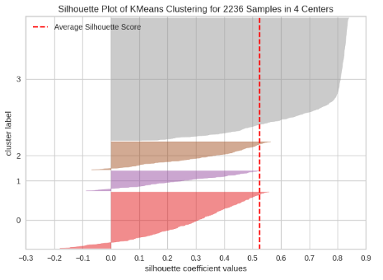
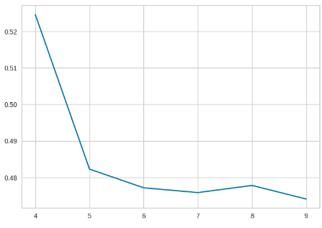
Clustering
Silhouette score is calculated to measure of how similar an object is to its own cluster compared to other clusters. It ranges from -1 to 1, where a higher value indicates better separation between clusters.
SilhouetteVisualizer, visualizes the silhouette scores for each sample and the average silhouette score of all samples. It helps evaluate the quality of clustering visually.
A loop iterates through a range of cluster numbers from 4 to 9 to find out the optimum number of clusters. For each number of clusters, KMeans is applied to the data and silhouette score is calculated.
The silhouette scores are plotted against the number of clusters to determine the optimal number of clusters

Slide 21
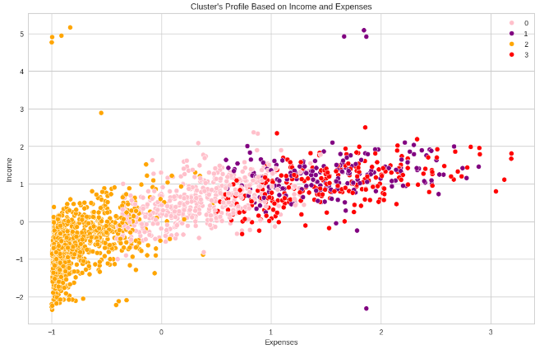
Clustering
A scatter plot is created with 'Income' on the x-axis and 'Expenses' on the y-axis.
Data points are colored according to their cluster labels, and different colors represent different clusters.
Income vs spending plot shows the clusters pattern
group 0: low spending & average income
group 1: high spending & average income
group 2: low spending & low income
group 3: high spending & high income

Slide 22
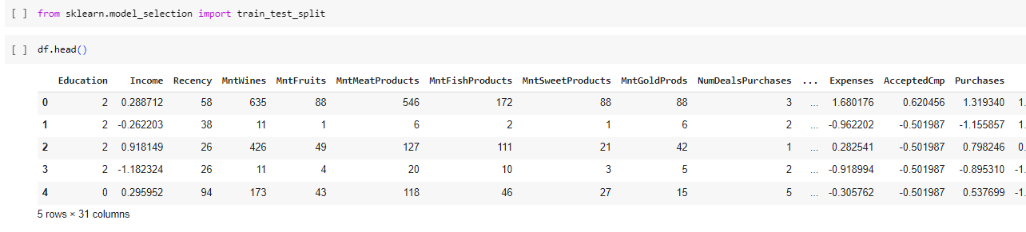
Splitting the data

Slide 23
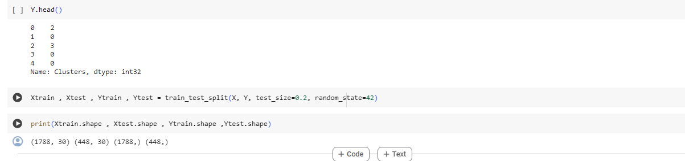
Train and Test result

Slide 24
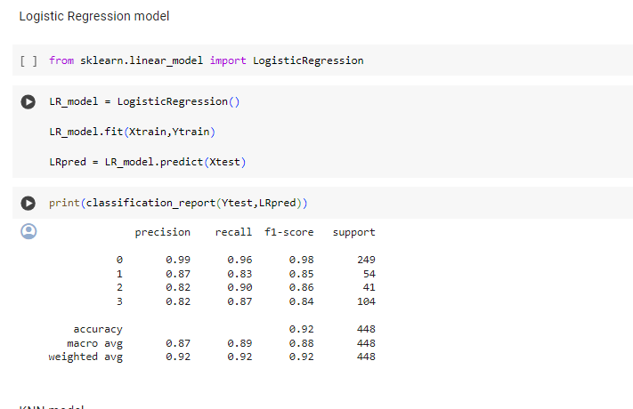
Logistic Regression model

Slide 25
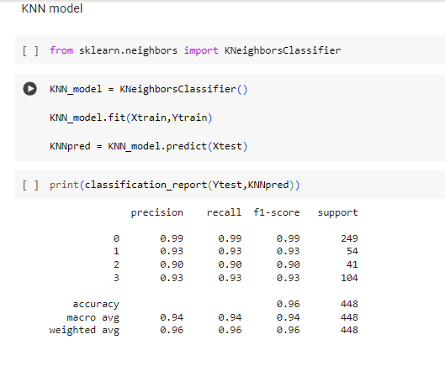
KNN Model

Slide 26
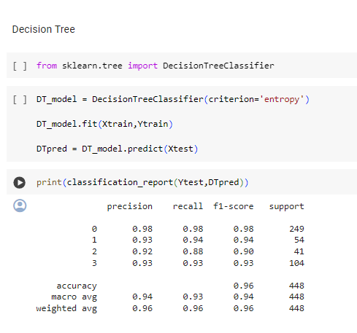
Decision Tree

Slide 27
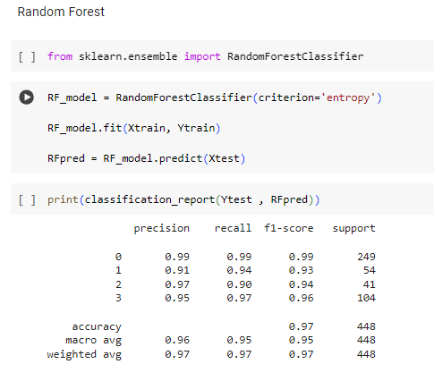
Random Forest

Slide 28
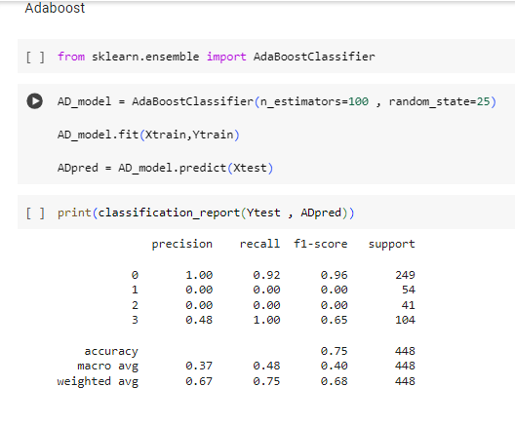
Adaboost
we can see.
Which has less accuracy than any other model

Slide 29
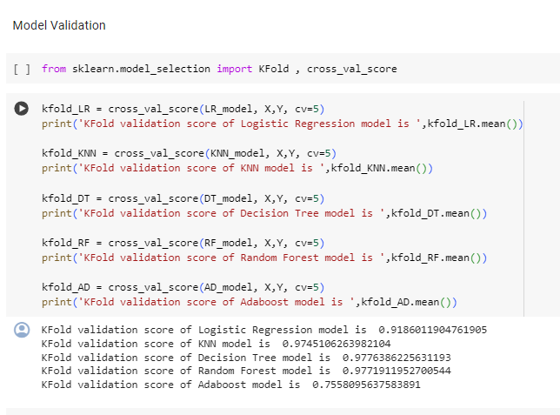
Model Validation

Slide 30
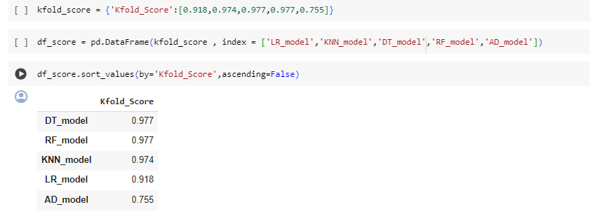
Comparing the all models

Slide 31
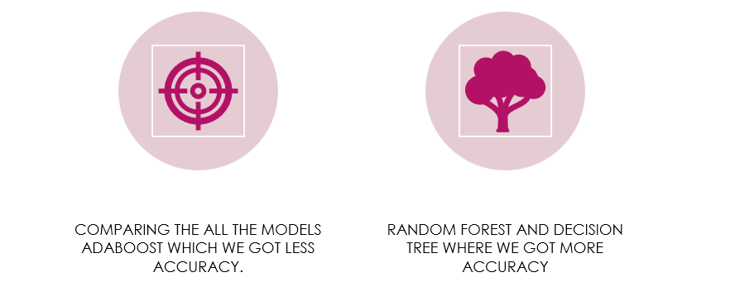
Conclusion

Slide 32
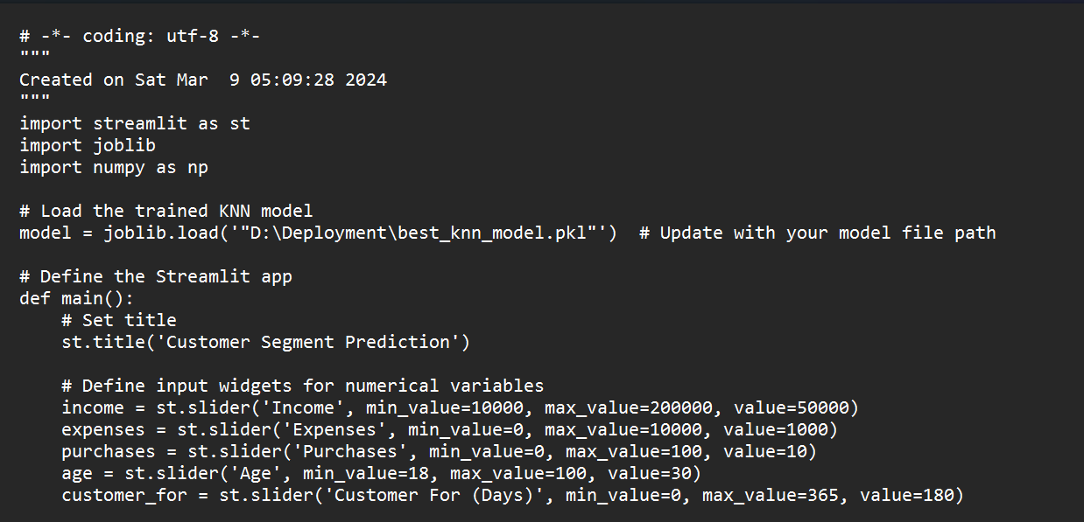
.py file

Slide 33
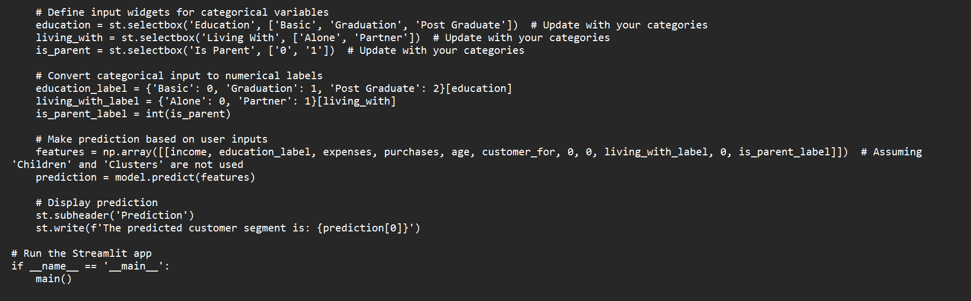

Slide 34
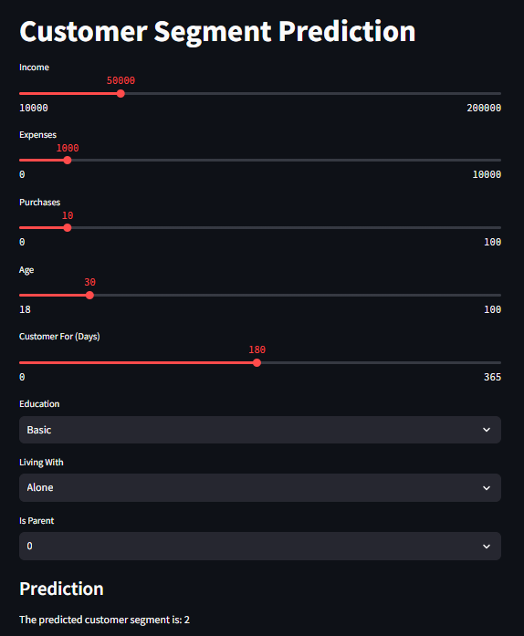
Deployment

Slide 35
Challenges Faced
Data analysis : One of the biggest challenging is data analysis is ensuring the quality of the data you are working with because data quality refers to the accuracy and relevance of the data for your specific purposes.
Dealing with Outliers: Outliers can significantly impact clustering results, especially in algorithms sensitive to them, such as K-means. Deciding whether to remove outliers or adjust the algorithm's sensitivity to them requires careful consideration.
Handling Missing Data: Many clustering algorithms cannot handle missing values, so dealing with missing data is a common challenge. Imputation techniques or algorithms that can handle missing values may be necessary.
Determining the Number of Clusters: Deciding on the optimal number of clusters can be subjective and challenging. Using techniques like the elbow method or silhouette analysis can help, but they may not always provide clear-cut answers.

Slide 36
Challenges Faced
Handling High-Dimensional Data: Clustering high-dimensional data can be challenging due to the curse of dimensionality. It may be necessary to perform dimensionality reduction techniques such as PCA (Principal Component Analysis) before clustering.
Choosing the Right Algorithm: Selecting the appropriate clustering algorithm for your dataset can be challenging. Different algorithms have different assumptions and may perform better or worse depending on the nature of the data and the desired outcome. Further more we utilized various method and tools such as cluster analysis decision tree, KNN logistics regression Ada boost and Random forest and this are beneficial in this process.
Reproducibility: Ensuring that clustering results are reproducible can be challenging due to the randomness inherent in some algorithms, such as K-means. Setting random seeds and documenting the process can help ensure reproducibility.

Slide 37
Thank you

